Slide 1

Classical Machine Learning Algorithm:
SVM and Boosting
王立威
北京大学

Slide 2

Content
SVM
Boosting

Slide 3
Content
SVM
Boosting

Slide 4
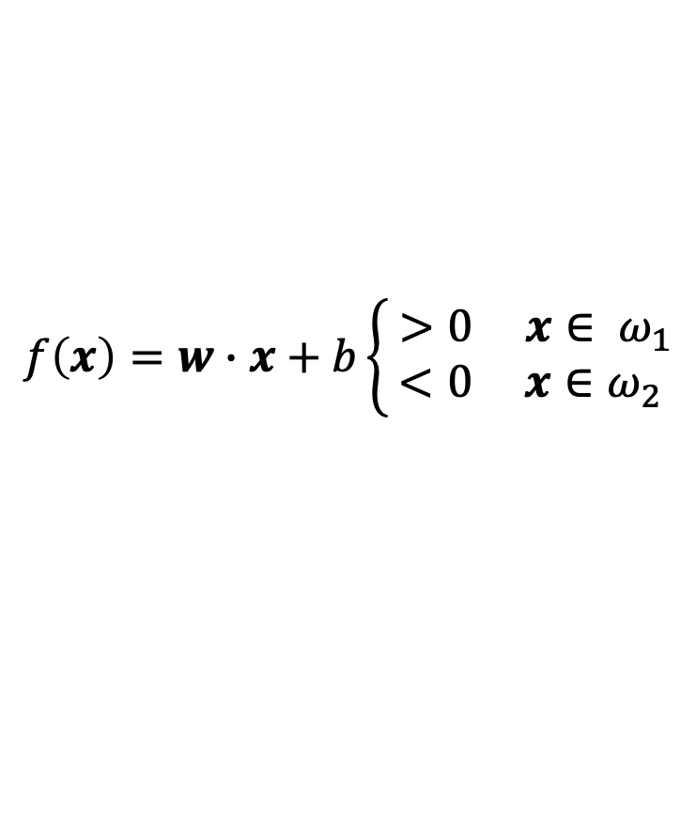
Classification
Classification is one of the most fundamental problem in machine learning.
How to find a hyperplane that separates all the data correctly?
For linear separable data:
y=-1
y=+1
$$f\left(x\right)=w∙x+b\left\{\begin{aligned} >0 x∈ ω_{1} \\ <0 x∈ω_{2}\end{aligned}\right.$$

Slide 5
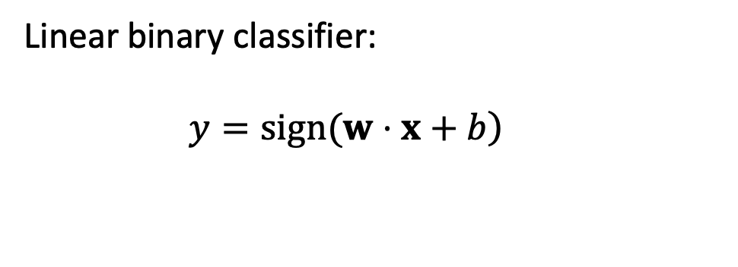

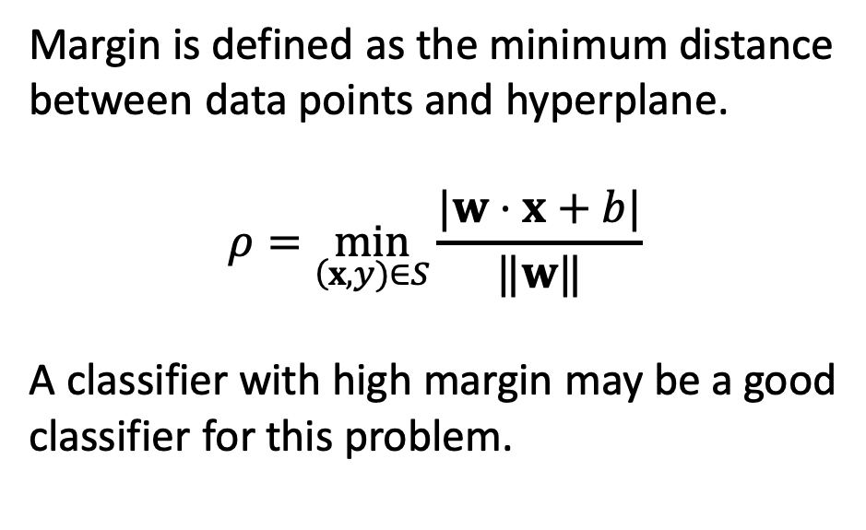
Linear Classifier
Linear binary classifier:
$\left.y=sign(w⋅x+b\right)$
y=-1
$$ρ$$
y=+1
$$ρ$$
Margin is defined as the minimum distance between data points and hyperplane.
$$ρ=\min_{\left(x,y)∈S\right.}\frac{|w⋅x+b|}{‖w‖}$$
A classifier with high margin may be a good classifier for this problem.

Slide 6

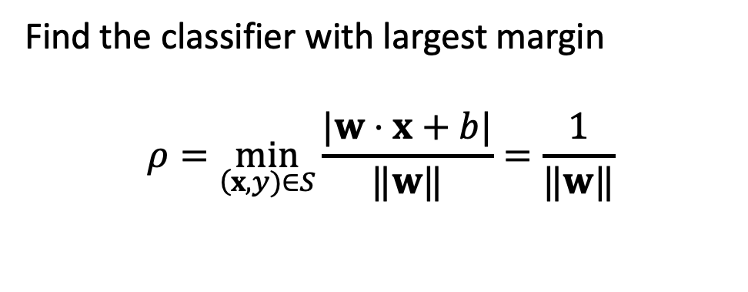


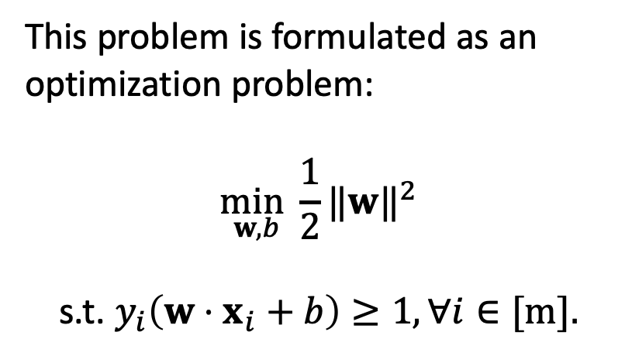
Support Vector Machine
Find the classifier with largest margin
$$ρ=\min_{\left(x,y)∈S\right.}\frac{|w⋅x+b|}{‖w‖}=\frac{1}{‖w‖}$$
y=-1
$$ρ$$
y=+1
$$ρ$$
This problem is formulated as an optimization problem:
$$\min_{w,b}\frac{1}{2}{‖w‖}^{2}$$
                s.t. $y_{i}\left(w⋅x_{i}+b\right)≥1,∀i∈[m].$
$w⋅x+b$ = +1
$w⋅x+b$ = -1
$w⋅x+b$ = -1
$w⋅x+b$ = -1
$w⋅x+b$ = -1
$w⋅x+b$ = -1
$w⋅x+b$ = -1
$w⋅x+b$ = -1
$w⋅x+b$ = -1
$w⋅x+b$ = -1
$w⋅x+b$ = -1
$w⋅x+b$ = -1
$w⋅x+b$ = -1

Slide 7
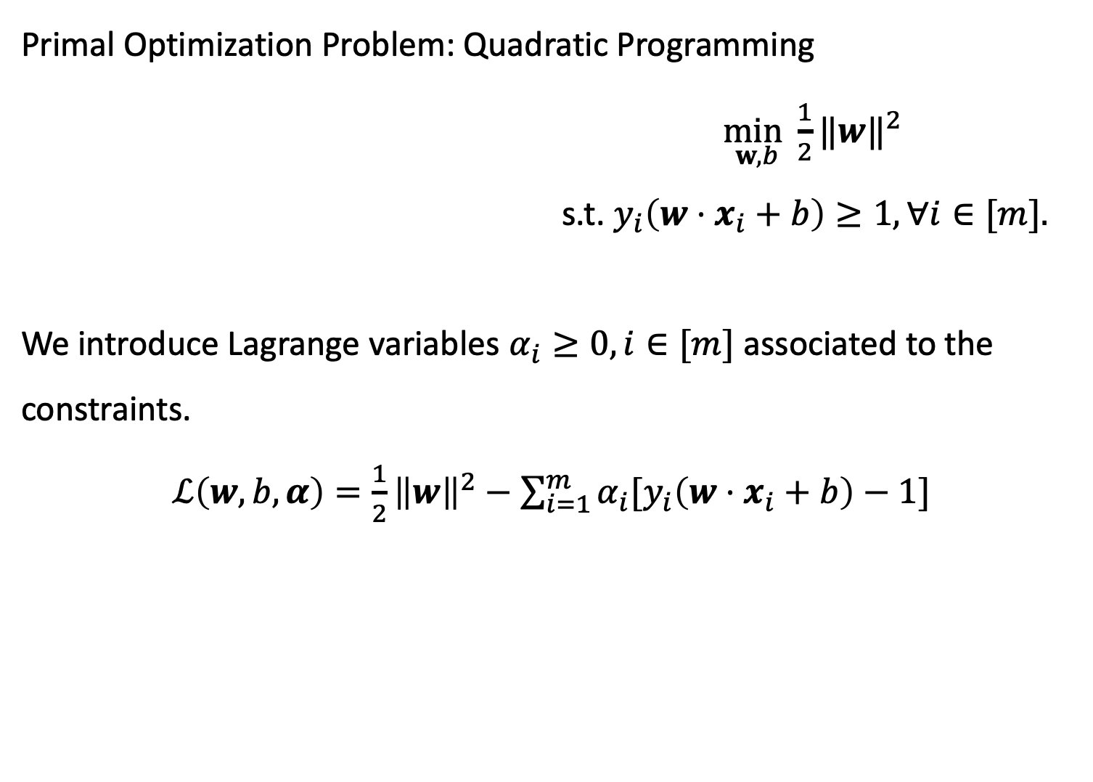
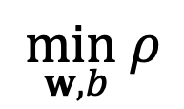
Support Vector Machine
Primal Optimization Problem: Quadratic Programming
                $\min_{w,b}\frac{1}{2}{‖w‖}^{2}$
                s.t. $y_{i}\left(w⋅x_{i}+b\right)≥1,∀i∈[m].$
We introduce Lagrange variables $α_{i}≥0, i∈[m]$ associated to the constraints.
$ℒ\left(w,b,α\right)=\frac{1}{2}{\left\|w\right\|}^{2}−\sum_{i=1}^{m}{α_{i}[y_{i}\left(w⋅x_{i}+b\right)−1]}$
$$\min_{w,b}ρ$$

Slide 8
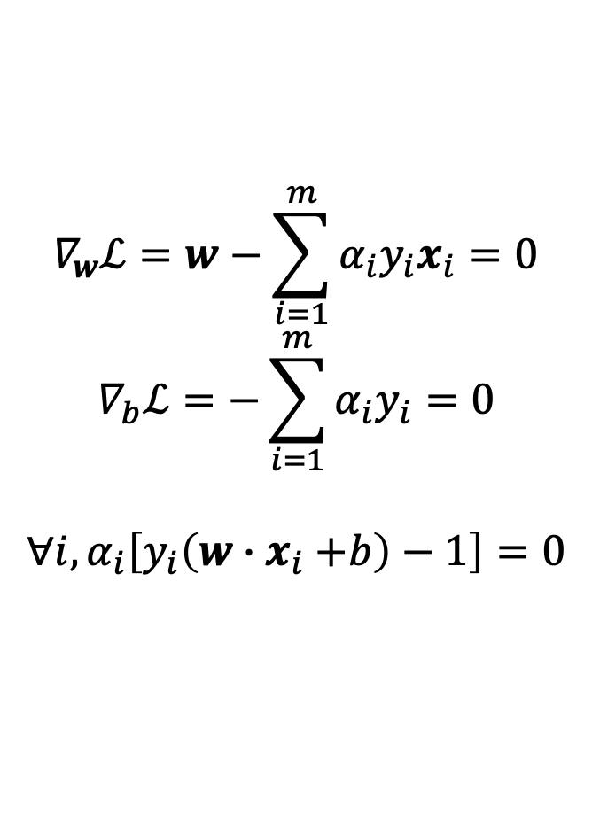
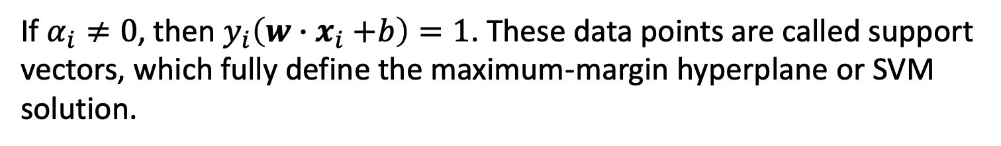

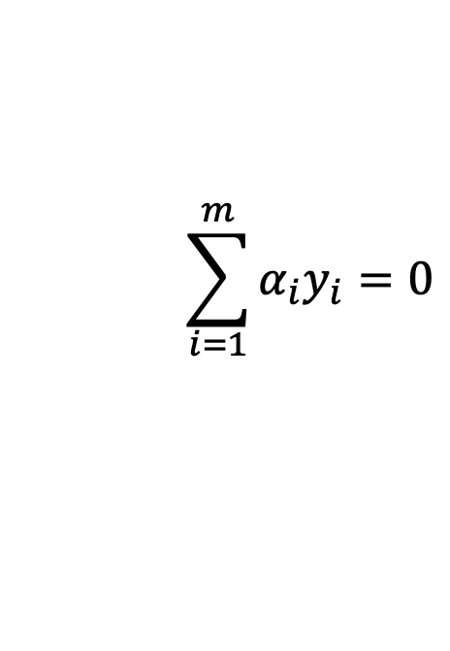
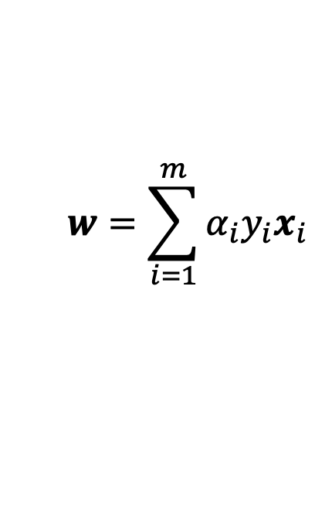
KKT Conditions
$$∇_{w}ℒ=w−\sum_{i=1}^{m}{α_{i}y_{i}x_{i}}=0$$
$$∇_{b}ℒ=−\sum_{i=1}^{m}{α_{i}y_{i}}=0$$
$$∀i, α_{i}\left[y_{i}\left(w{∙x}_{i}+b\right)−1\right]=0$$
$$w=\sum_{i=1}^{m}{α_{i}y_{i}x_{i}}$$
$$\sum_{i=1}^{m}{α_{i}y_{i}}=0$$
$$α_{i}=0∨y_{i}\left(w{∙x}_{i}+b\right)=1$$
If $α_{i}≠0$, then $y_{i}\left(w{∙x}_{i}+b\right)=1$. These data points are called support vectors, which fully define the maximum-margin hyperplane or SVM solution.

Slide 9
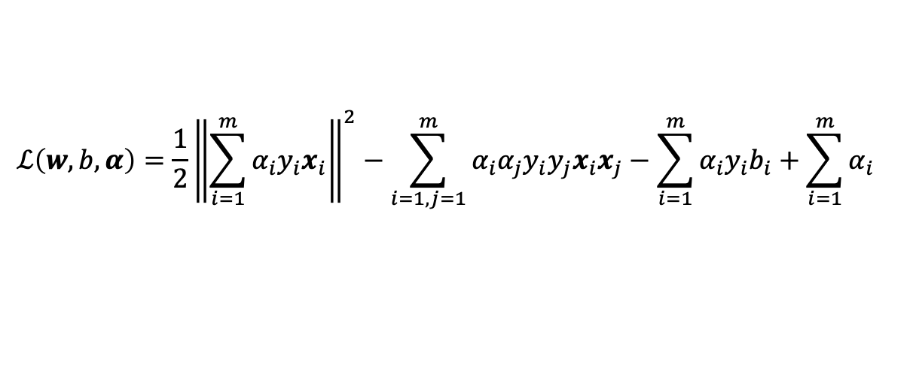
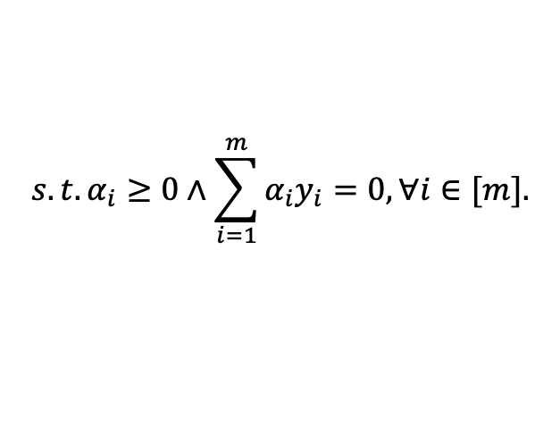
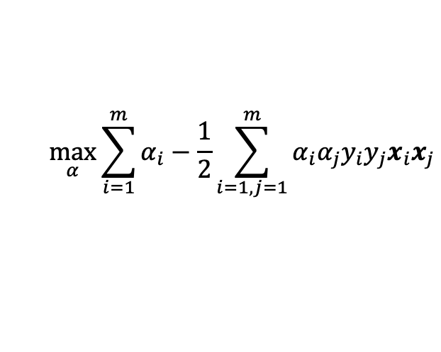
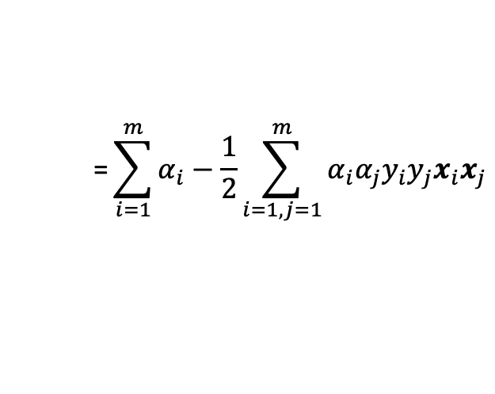
Dual Problem
We plug into the Lagrangian the definition of w in terms of the dual variables.
This leads to the following dual problem for SVM.
$$ℒ\left(w,b,α\right)=\frac{1}{2}{\left\|\sum_{i=1}^{m}{α_{i}y_{i}x_{i}}\right\|}^{2}−\sum_{i=1,j=1}^{m}{α_{i}α_{j}y_{i}y_{j}x_{i}x_{j}}−\sum_{i=1}^{m}{α_{i}y_{i}b_{i}}+\sum_{i=1}^{m}{α_{i}}$$
$$\text{=}\sum_{i=1}^{m}{α_{i}}−\frac{1}{2}\sum_{i=1,j=1}^{m}{α_{i}α_{j}y_{i}y_{j}x_{i}x_{j}}$$
$$\max_{α}{\sum_{i=1}^{m}{α_{i}}−\frac{1}{2}\sum_{i=1,j=1}^{m}{α_{i}α_{j}y_{i}y_{j}x_{i}x_{j}}}$$
$$s.t.α_{i}≥0∧\sum_{i=1}^{m}{α_{i}y_{i}}=0,∀i∈[m].$$

Slide 10

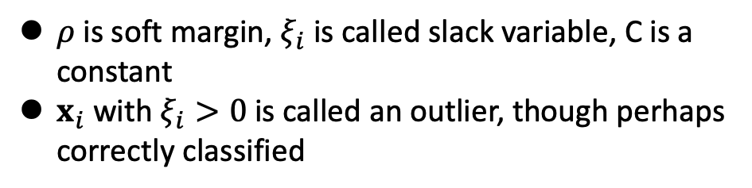
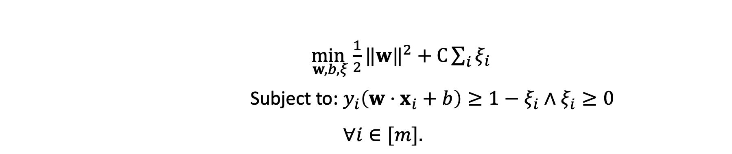
Non-separable case
We introduce slack variables $ξ_{i}$ to relax the constraints.
                $\min_{w,b,ξ}\frac{1}{2}{‖w‖}^{2}+C\sum_{i}{ξ_{i}}$
                Subject to: $y_{i}\left(w⋅x_{i}+b\right)≥1−ξ_{i}∧ξ_{i}≥0$
                $∀i∈[m].$
y=-1
$$ρ$$
y=+1
$$ρ$$
$ρ$ is soft margin, $ξ_{i}$ is called slack variable, C is a constant
$x_{i}$ with $ξ_{i}>0$ is called an outlier, though perhaps correctly classified

Slide 11
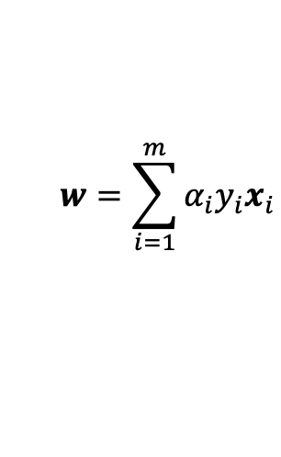
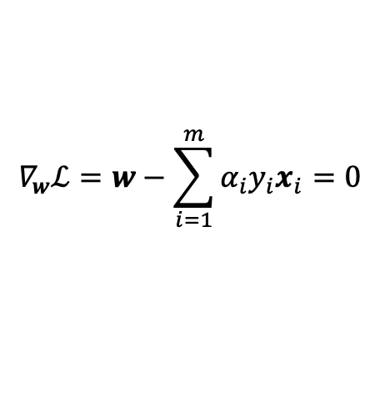






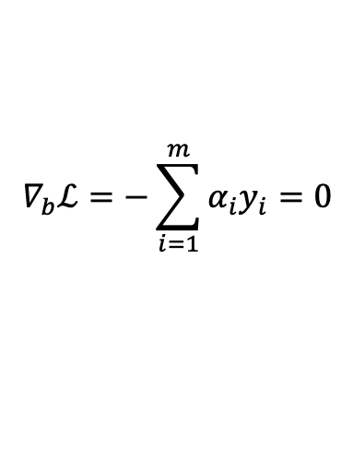
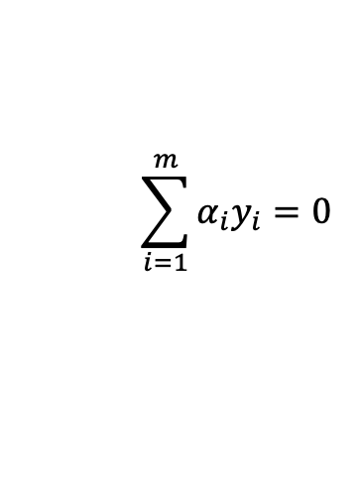
KKT Conditions
$$∇_{w}ℒ=w−\sum_{i=1}^{m}{α_{i}y_{i}x_{i}}=0$$
$$w=\sum_{i=1}^{m}{α_{i}y_{i}x_{i}}$$
$$∇_{b}ℒ=−\sum_{i=1}^{m}{α_{i}y_{i}}=0$$
$$\sum_{i=1}^{m}{α_{i}y_{i}}=0$$
$$∀i, ∇_{ξ_{i}}ℒ=C−α_{i}−β_{i}=0$$
$$α_{i}+β_{i}=C$$
$$∀i, α_{i}\left[y_{i}\left(w{∙x}_{i}+b\right)−1+ξ_{i}\right]=0$$
$$α_{i}=0∨y_{i}\left(w{∙x}_{i}+b\right)=1−ξ_{i}$$
$$∀i, β_{i}ξ_{i}=0$$
$$β_{i}=0 ∨ξ_{i}=0$$
Some data points are support vectors, which fully define the soft margin hyperplane or SVM solution.

Slide 12
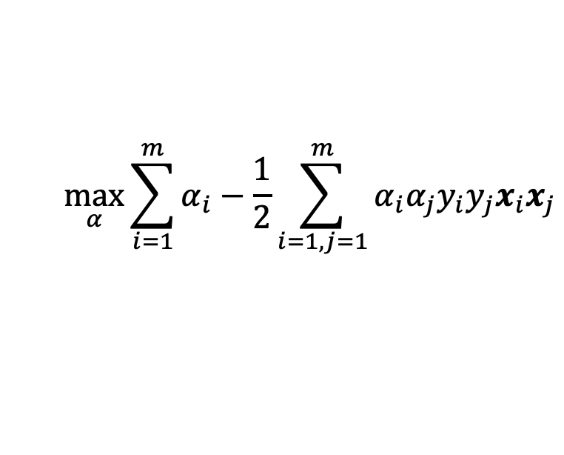
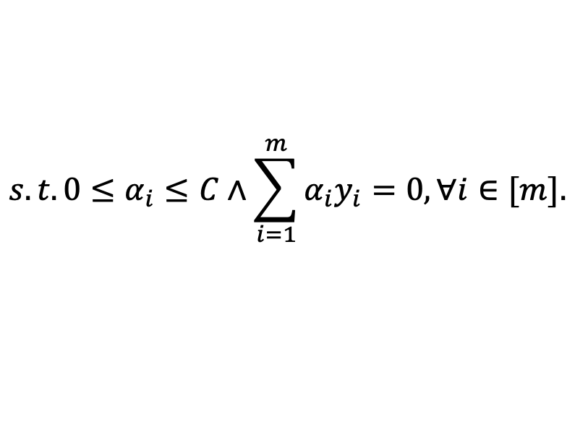
Dual Problem
Similarly, We get the dual form of SVM in Non-separable case.
$$\max_{α}{\sum_{i=1}^{m}{α_{i}}−\frac{1}{2}\sum_{i=1,j=1}^{m}{α_{i}α_{j}y_{i}y_{j}x_{i}x_{j}}}$$
$$s.t.0≤α_{i}≤C∧\sum_{i=1}^{m}{α_{i}y_{i}}=0,∀i∈[m].$$

Slide 13
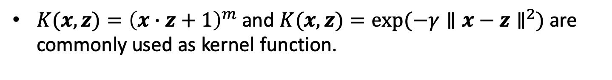
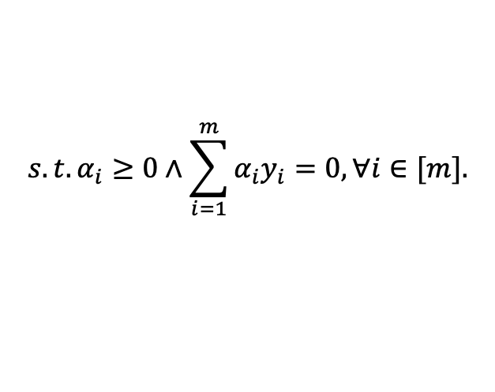
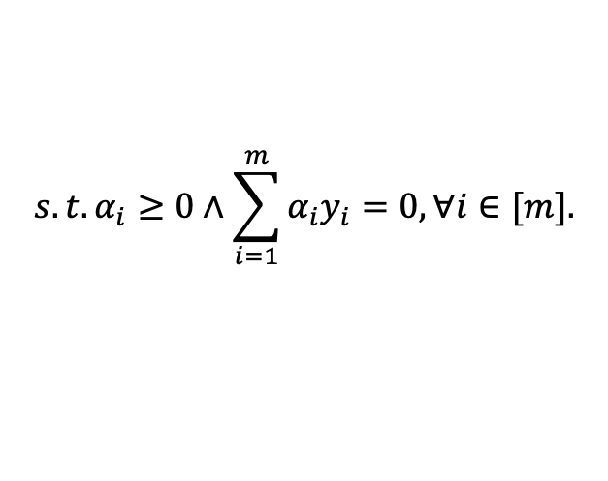
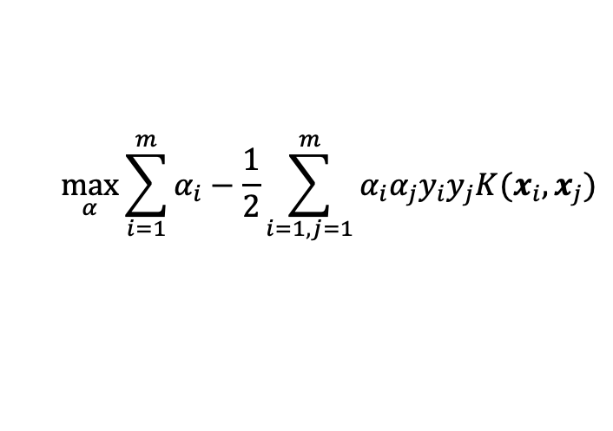
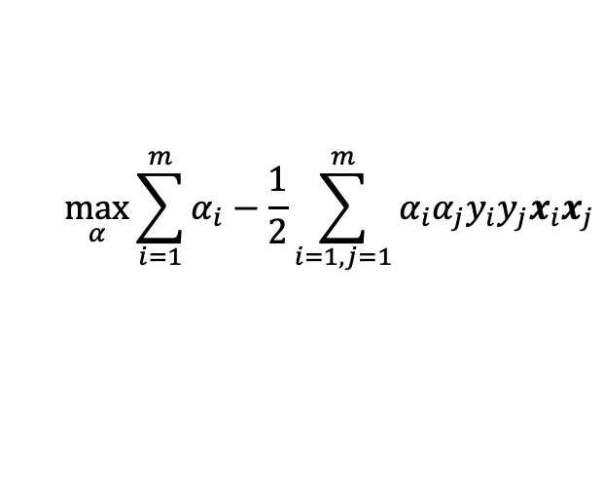
Kernel SVM
Some data may be not linear separable in data space, but are linear separable in some feature space.
We use some function to map data from data space to feature space.
$$\max_{α}{\sum_{i=1}^{m}{α_{i}}−\frac{1}{2}\sum_{i=1,j=1}^{m}{α_{i}α_{j}y_{i}y_{j}x_{i}x_{j}}}$$
$$\max_{α}{\sum_{i=1}^{m}{α_{i}}−\frac{1}{2}\sum_{i=1,j=1}^{m}{α_{i}α_{j}y_{i}y_{j}K(x_{i},x_{j})}}$$
$$s.t.α_{i}≥0∧\sum_{i=1}^{m}{α_{i}y_{i}}=0,∀i∈[m].$$
$$s.t.α_{i}≥0∧\sum_{i=1}^{m}{α_{i}y_{i}}=0,∀i∈[m].$$
$K(x,z)={\left(x∙z+1\right)}^{m}$ and $K(x,z)=exp⁡(−γ∥x−z∥^{2})$ are commonly used as kernel function.

Slide 14
Content
SVM
Boosting

Slide 15
Introduction
It‘s often difficult to directly learn an accurate model for a non-trivial task.
How to use some weak learning algorithm to build a strong learner?
AdaBoost is one of the most prevalent and successful boosting algorithms.

Slide 16
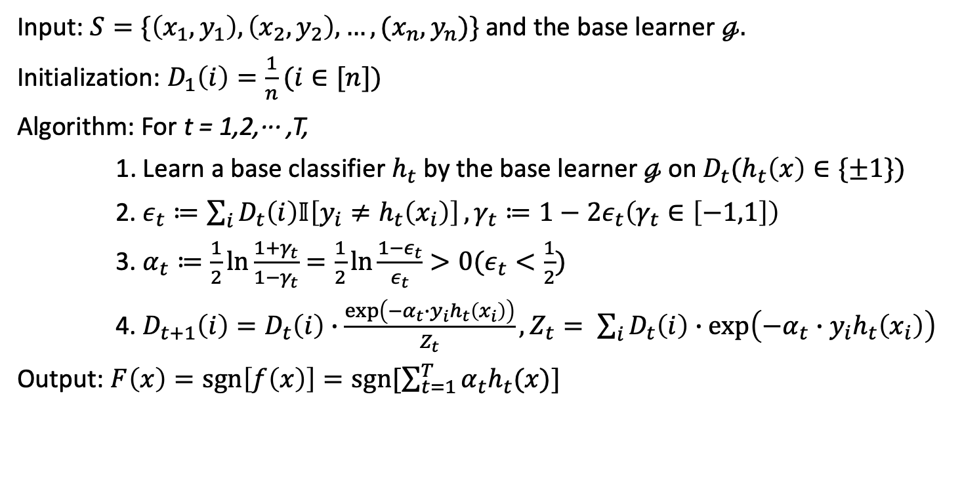
Adaboost
Input: $S=\{\left(x_{1},y_{1}\right),\left(x_{2},y_{2}\right),…,(x_{n},y_{n})\}$ and the base learner $ℊ.$
Initialization: $D_{1}\left(i\right)=\frac{1}{n}(i∈[n])$
Algorithm: For t = 1,2,··· ,T,
1. Learn a base classifier $h_{t}$ by the base learner $ℊ$on $D_{t}(h_{t}\left(x\right)∈\{±1\})$
2. $ε_{t}≔\sum_{i}{D_{t}\left(i\right)𝕀\left[y_{i}≠h_{t}\left(x_{i}\right)\right]},γ_{t}≔1−2ε_{t}\left(γ_{t}∈\left[−1,1\right]\right)$
3. $α_{t}≔\frac{1}{2}\ln{\frac{1+γ_{t}}{1−γ_{t}}}=\frac{1}{2}\ln{\frac{1−ε_{t}}{ε_{t}}}>0(ε_{t}<\frac{1}{2})$
4. $D_{t+1}\left(i\right)=D_{t}\left(i\right)∙\frac{\exp\left(−α_{t}∙y_{i}h_{t}\left(x_{i}\right)\right)}{Z_{t}}, Z_{t}= \sum_{i}{D_{t}\left(i\right)∙\exp\left(−α_{t}∙y_{i}h_{t}\left(x_{i}\right)\right)}$
Output: $F\left(x\right)=sgn\left[f\left(x\right)\right]=sgn[\sum_{t=1}^{T}{α_{t}h_{t}(x)}]$

Slide 17
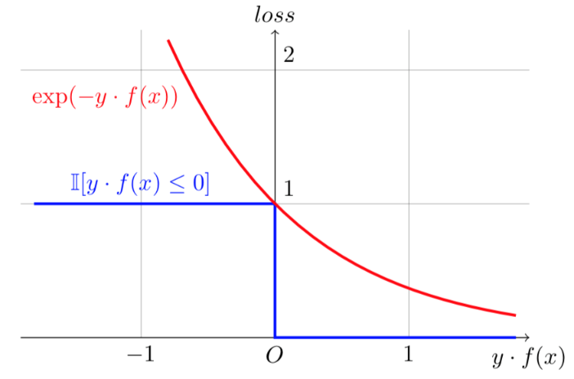
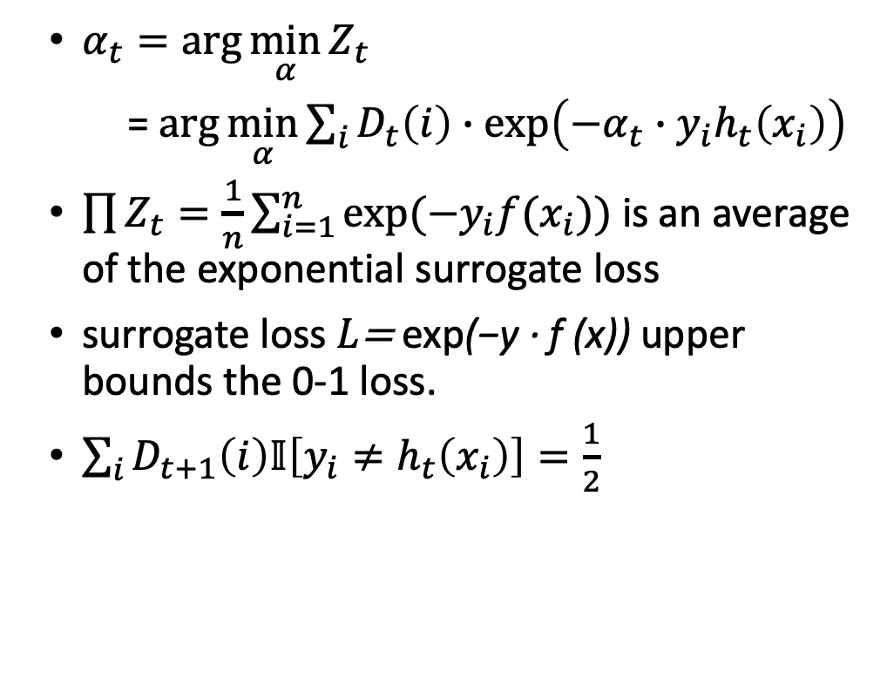
Properties of AdaBoost
$α_{t}=\arg{\min_{α}{Z_{t}}}$
= $\arg{\min_{α}{\sum_{i}{D_{t}\left(i\right)∙\exp\left(−α_{t}∙y_{i}h_{t}\left(x_{i}\right)\right)}}}$
$\prod{Z_{t}}=\frac{1}{n}\sum_{i=1}^{n}{exp⁡(−y_{i}f(x_{i}))}$ is an average of the exponential surrogate loss
surrogate loss $L\text{= }\text{exp}\text{(}\text{−}\text{y}\text{ · }\text{f}\text{ (}\text{x}\text{))}$upper bounds the 0-1 loss.
$\sum_{i}{D_{t+1}\left(i\right)𝕀\left[y_{i}≠h_{t}\left(x_{i}\right)\right]}=\frac{1}{2}$

Slide 18
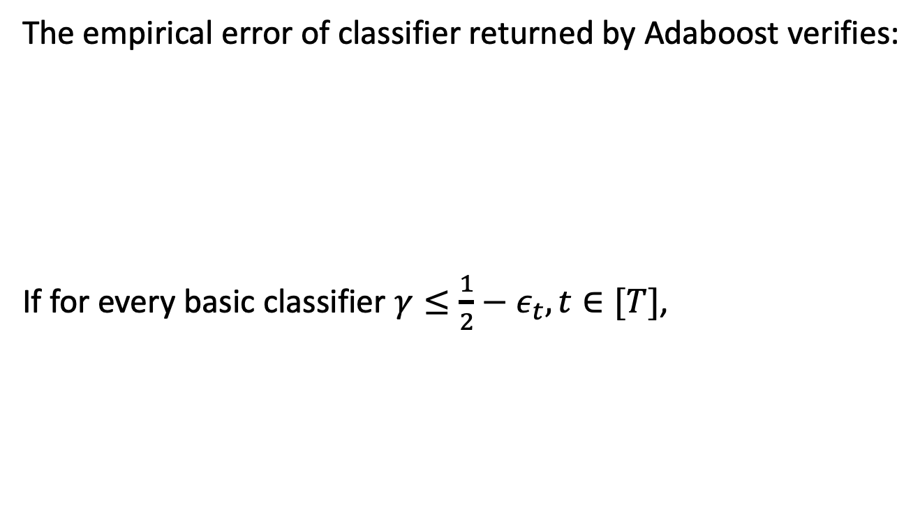

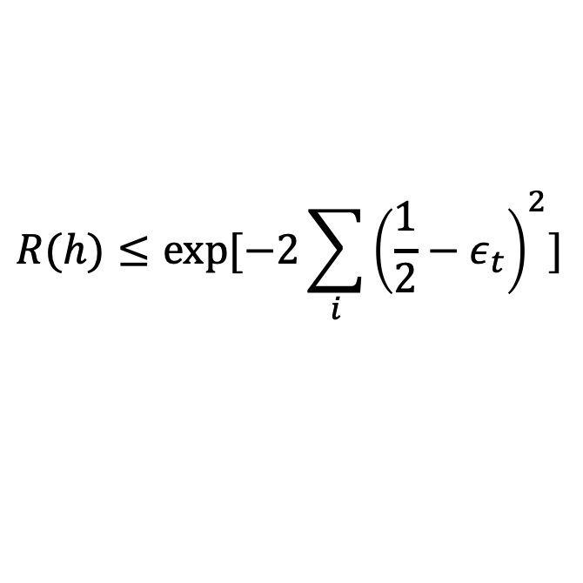
Properties of AdaBoost
The empirical error of classifier returned by Adaboost verifies:
If for every basic classifier $γ≤\frac{1}{2}−ε_{t}, t∈[T]$,
$$R(h)≤\exp{[−2\sum_{i}{{\left(\frac{1}{2}−ε_{t}\right)}^{2}]}}$$
$$R(h)≤\exp{(−2γ^{2}T)}$$

Slide 19



